Slide 1

Strengthening Schoolwide Family Engagement Practices
Maria Fernandez l Mary Stach l D’Lisa Crain ​
February 7, 2025

Slide 2

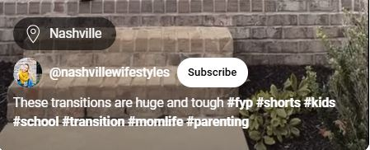

Slide 3
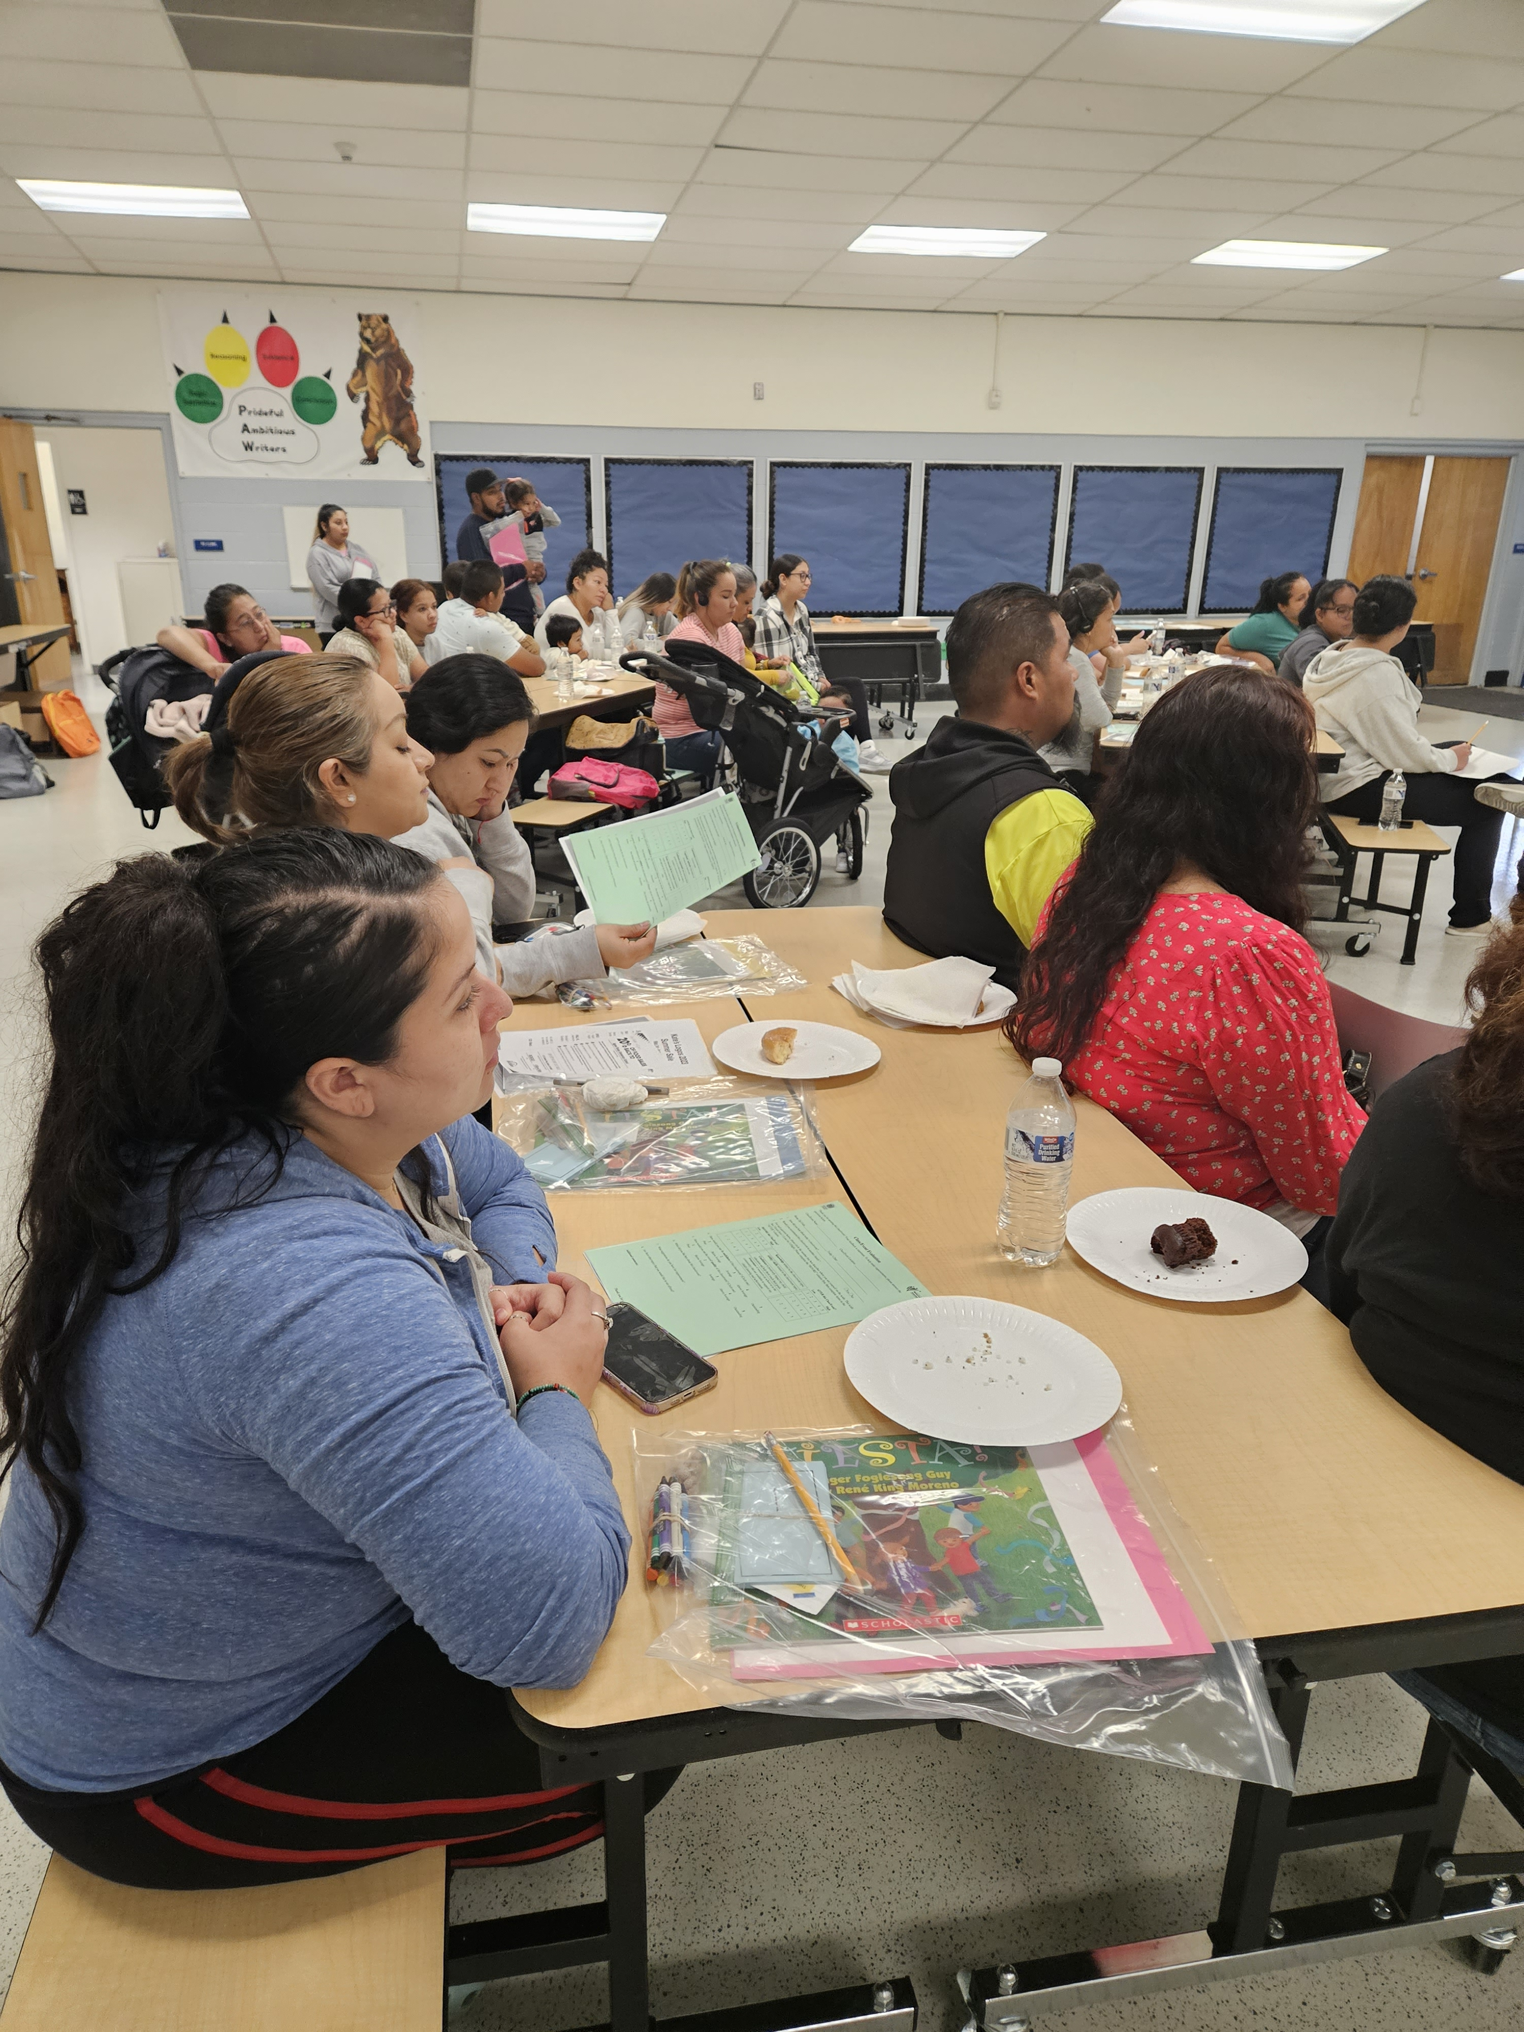
Share a time that your school's transition practices with families were impactful.
Why were they impactful and what did they impact?

Slide 4

Learn how effective transition processes and practices make a difference.
So we can plan practices that connect families, staff, and students and build capacity of staff and families to partner together to support children’s education.
This Photo by Unknown Author is licensed under CC BY

Slide 5






Transactional vs. Transformational Engagement Practices

Slide 6
Transformative changes are more fundamental changes in the structures and systems that shape group outcomes. Transformative changes can be more durable over time and have greater effects as the causes of problems are alleviated—not just their effects.
© 2024 Othering and Belonging Institute. All rights reserved. - University of California, Berkeley

Slide 7
Connect with your Peers
Capabilities (skills and knowledge)
Connections (networks)
Cognition (shift in beliefs, values)
Confidence (self-efficacy)

Slide 8
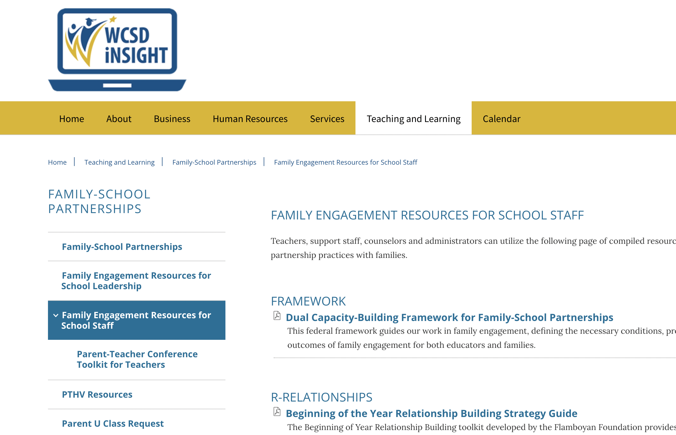
REMINDER: Family Transitions Toolkits

Slide 9

What's one thing you will implement to balance your transition practices WITH FAMILIES to be transactional AND transformational?

Slide 10

Thank You for Your Feedback
2/7/2025

